Slide 1
Risk
Quantitative Analysis, Response Planning

Slide 2
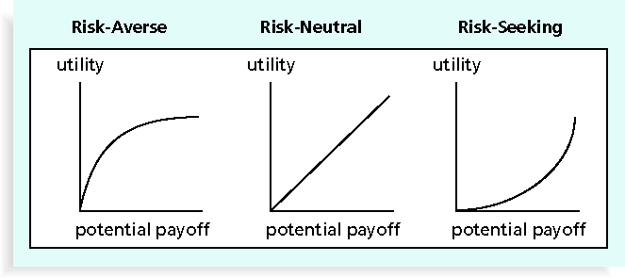
Figure 11-2. Risk Utility Function and Risk Preference
Information Technology Project Management, Sixth Edition

Slide 3
Risk Utility
Risk utility or risk tolerance is the amount of satisfaction or pleasure received from a potential payoff
  Utility rises at a decreasing rate for people who are risk-averse
  Those who are risk-seeking have a higher tolerance for risk, and their satisfaction increases when more payoff is at stake
  The risk-neutral approach achieves a balance between risk and payoff
Information Technology Project Management, Sixth Edition

Slide 4
Project Risk Management Processes (continued)
Performing quantitative risk analysis: numerically estimating the effects of risks on project objectives
Planning risk responses: taking steps to enhance opportunities and reduce threats to meeting project objectives
Monitoring and controlling risks: monitoring identified and residual risks, identifying new risks, carrying out risk response plans, and evaluating the effectiveness of risk strategies throughout the life of the project
Information Technology Project Management, Sixth Edition

Slide 5
Performing Quantitative Risk Analysis
Often follows qualitative risk analysis, but both can be done together
Large, complex projects involving leading edge technologies often require extensive quantitative risk analysis
Main techniques include:
  Decision tree analysis
  Simulation
  Sensitivity analysis
Information Technology Project Management, Sixth Edition

Slide 6
Decision Trees and Expected Monetary Value (EMV)
A decision tree is a diagramming analysis technique used to help select the best course of action in situations in which future outcomes are uncertain
Estimated monetary value (EMV) is the product of a risk event probability and the risk event’s monetary value
You can draw a decision tree to help find the EMV
Information Technology Project Management, Sixth Edition

Slide 7
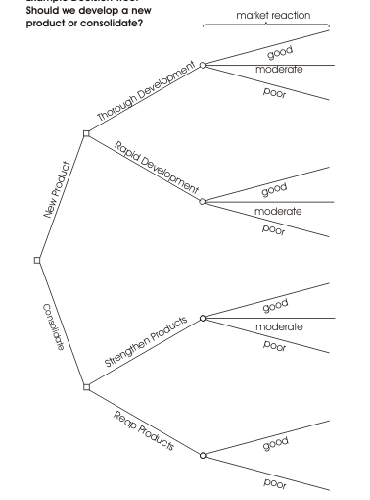
Expected Monetary Value (EMV) Example
Information Technology Project Management, Sixth Edition

Slide 8
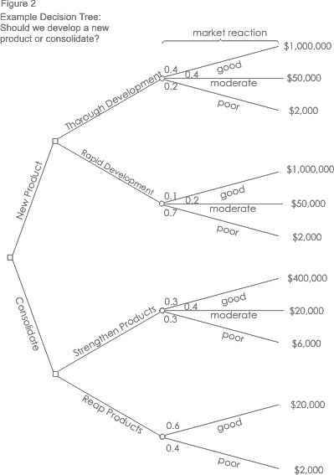
Expected Monetary Value (EMV) Example

Slide 9
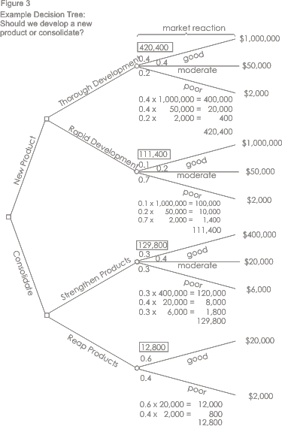
Expected Monetary Value (EMV) Example

Slide 10
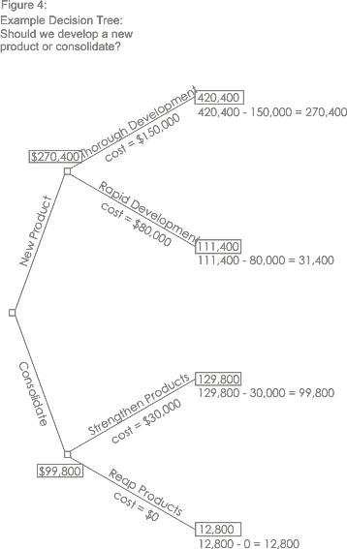
Expected Monetary Value (EMV) Example

Slide 11
Simulation
Simulation uses a representation or model of a system to analyze the expected behavior or performance of the system
Monte Carlo analysis simulates a model’s outcome many times to provide a statistical distribution of the calculated results
To use a Monte Carlo simulation, you must have three estimates (most likely, pessimistic, and optimistic) plus an estimate of the likelihood of the estimate being between the most likely and optimistic values
Information Technology Project Management, Sixth Edition

Slide 12
Steps of a Monte Carlo Analysis
Assess the range for the variables being considered
Determine the probability distribution of each variable
For each variable, select a random value based on the probability distribution
Run a deterministic analysis or one pass through the model
Repeat steps 3 and 4 many times to obtain the probability distribution of the model’s results
Information Technology Project Management, Sixth Edition

Slide 13
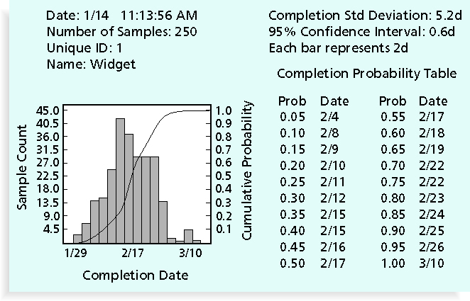
Figure 11-8. Sample Monte Carlo Simulation Results for Project Schedule
Information Technology Project Management, Sixth Edition

Slide 14
Sensitivity Analysis
Sensitivity analysis is a technique used to show the effects of changing one or more variables on an outcome
For example, many people use it to determine what the monthly payments for a loan will be given different interest rates or periods of the loan, or for determining break-even points based on different assumptions
Spreadsheet software, such as Excel, is a common tool for performing sensitivity analysis
Information Technology Project Management, Sixth Edition

Slide 15
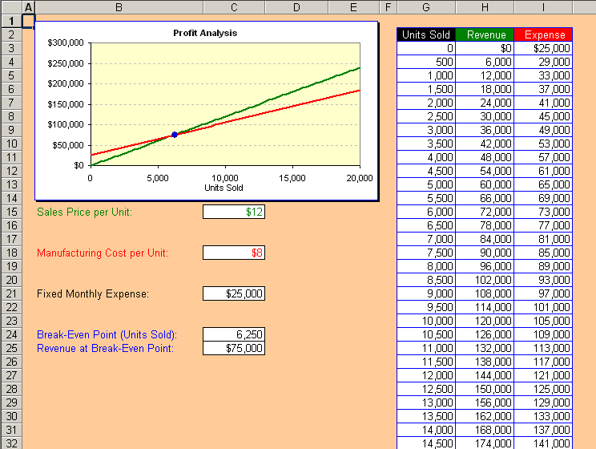
Figure 11-9. Sensitivity Analysis for Determining Break-Even Point
Information Technology Project Management, Sixth Edition

Slide 16
Planning Risk Responses
After identifying and quantifying risks, you must decide how to respond to them
Response strategies for negative risks
  Avoidance – Change the nature of the activities
  Acceptance – Calculate likelihood/impact - Accept chance
  Transference – Shift/Share ownership of impact
  Mitigation – minimize either likelihood or impact
    Prevention – reduce likelihood
    Recovery – reduce impact
Information Technology Project Management, Sixth Edition

Slide 17
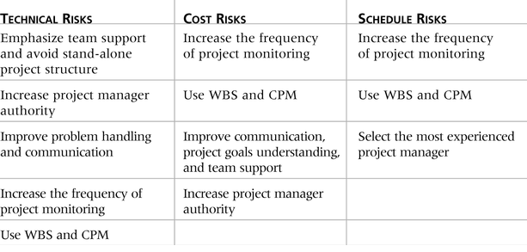
Table 11-7. General Risk Mitigation Strategies for Technical, Cost, and Schedule Risks
Information Technology Project Management, Sixth Edition

